Slide 1

AIRBNB HOTEL BOOKING ANALYSIS
Rishikesh Ranjan
INTERNSHIP_17546440516895be537820f

Slide 2

PROBLEM STATEMENT
Airbnb is a widely used platform that allows property owners to rent out their homes or apartments to travelers.
A major challenge for hosts is determining the optimal price for their listings, as pricing depends on multiple factors, including the number of bedrooms and bathrooms, cleanliness, accuracy of listing descriptions, and the quality of communication with guests.
Setting prices too high or too low can affect occupancy rates and revenue, making data-driven pricing decisions essential for both hosts and travelers.

Slide 3
Project Description This project aims to develop a machine learning model to predict Airbnb listing prices. Accurate pricing is essential for hosts to maximize occupancy and revenue, while ensuring travelers pay fair and competitive rates. Using historical Airbnb data, the project builds a regression model that captures the relationship between listing attributes—such as the number of bedrooms and bathrooms, property type, location, and guest ratings—and the price charged. The trained model can then predict prices for new or hypothetical listings, providing property owners with actionable insights to make data-driven pricing decisions and maintain a competitive edge in the market.

Slide 4

WHO ARE THE END USERS?
Airbnb Hosts :
To optimize the pricing of their listings based on property features, guest reviews, and market trends.
Travelers :
To assess whether a listing is fairly priced and make informed booking decisions.
Airbnb Platforms Analysts:
To enhance automated pricing recommendations, improve platform reliability, and build user trust.
Researchers/Students:
To study the relationship between property characteristics, guest feedback, and rental pricing for academic or practical insights.

Slide 5

Technology Used
Programming Languages: Python, R (for data analysis and modeling)
Data Analysis & Visualization: Pandas, NumPy, Matplotlib, Seaborn, Plotly
Machine Learning & Modeling: Scikit-learn (Regression models, Feature selection)
Data Preprocessing: Handling missing values, encoding categorical variables, scaling features
Development Environment: Jupyter Notebook, Google Colab
Database/Storage: CSV, Excel files, or SQL databases for storing Airbnb datasets
Version Control: Git/GitHub (for project management and collaboration)

Slide 6
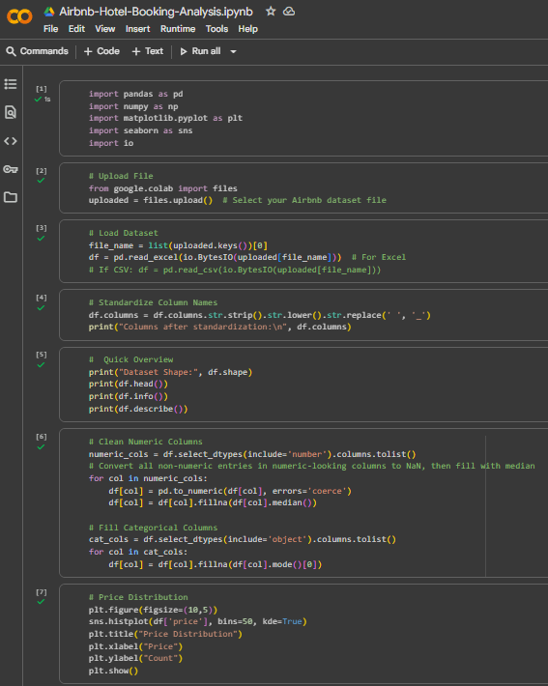
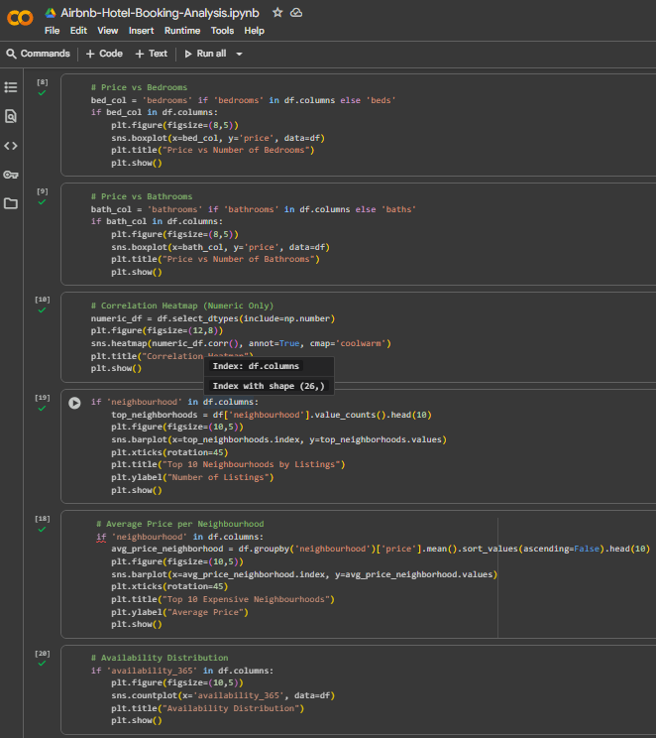
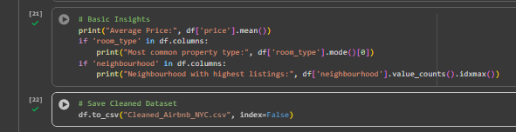
Python Code
Demo Link

Slide 7
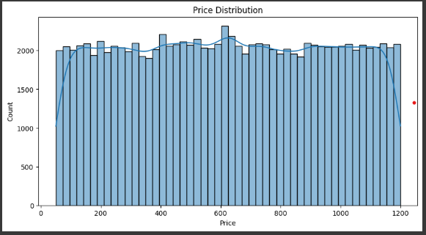
Result 1

Slide 8
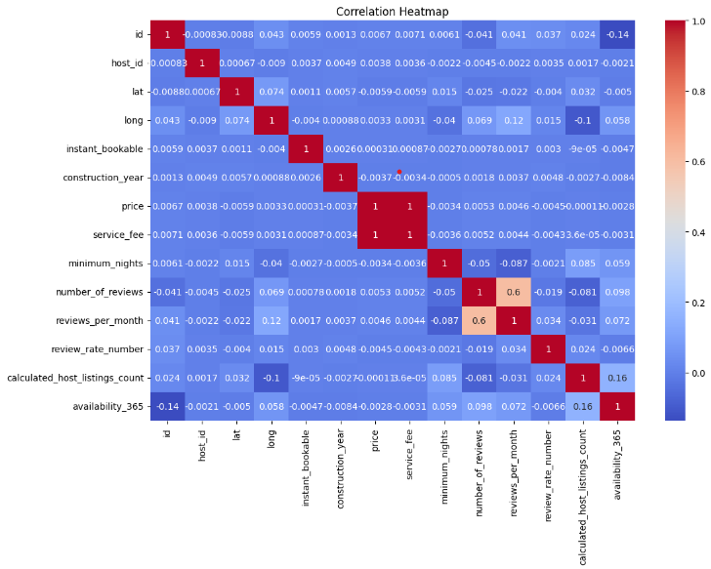
Result 2
Demo Link

Slide 9
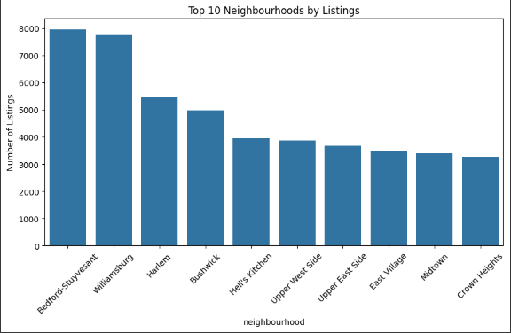
Result 3

Slide 10
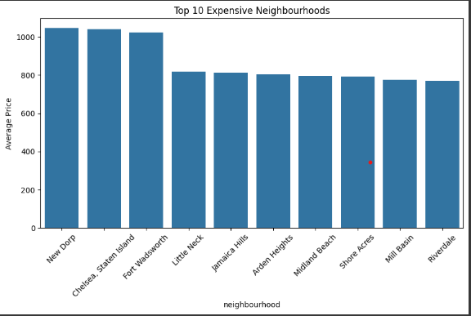
Result 4

Slide 11
Result 5
Demo Link

Slide 12
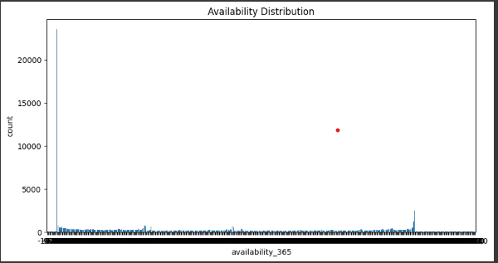
Result 6

Slide 13
GitHub repository
https://github.com/rishi18-SAIT/VOIS_AICTE_Oct2025_RishikeshRanjan.git
Demo Link

Slide 14
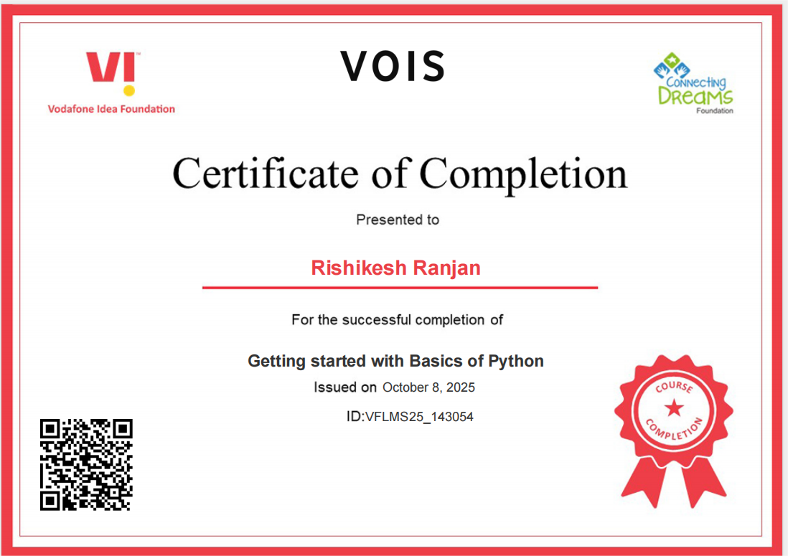
Getting started with Basics of Python Certificate

Slide 15
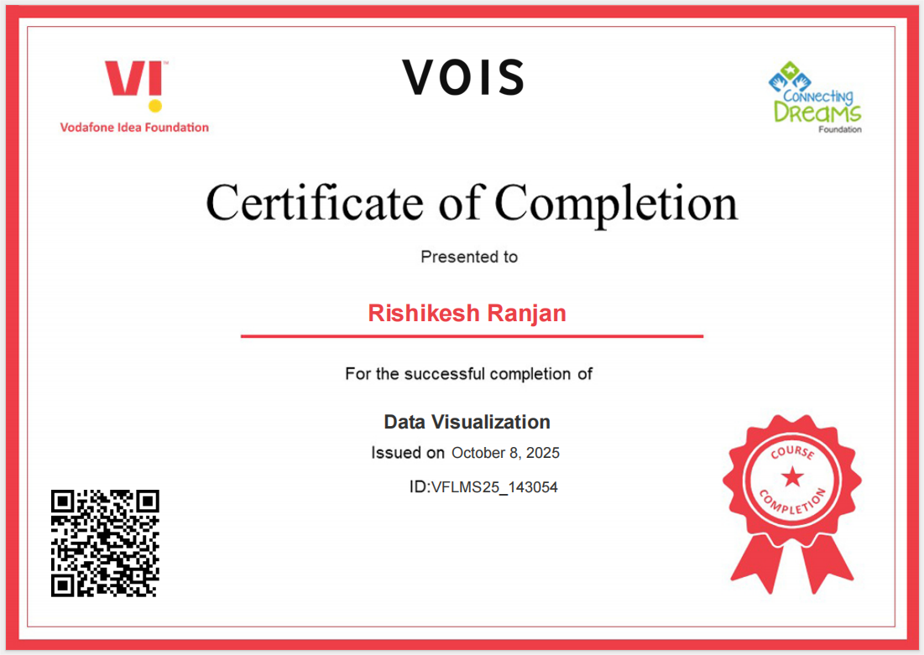
Data Visualization Certificate

Slide 16
Thank you
.
.

